Slide 1
Washington and the OCS
L. Poe Leggette
Partner-in-Charge, Denver Regional Head for the Americas, Energy
Fulbright & Jaworski LLP
January 23, 2014 T

Slide 2
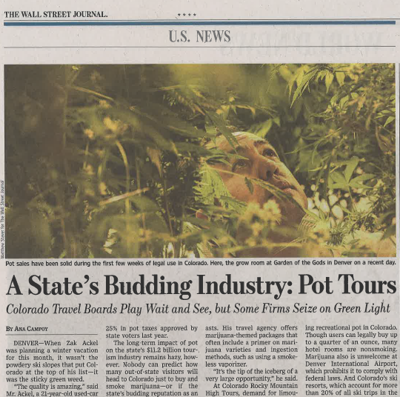
Introducing…Leggette Tour Company

Slide 3
Drilling Contract - Indemnity
Clause 24.1 Pollution.
CONTRACTOR shall assume full responsibility for and shall protect, release, defend, indemnify, and hold OPERATOR and its joint owners harmless from and against any loss, damage, expense, claim, fine, penalty, demand or liability for pollution or contamination, including control and removal thereof, originating on or above the surface of the land or water, from spills, leaks, discharges of fuels, lubricants, motor oils, pipe dope, paints, solvents, ballast, air emissions, bilge sludge, garbage, or any other liquid or solid whatsoever in possession and control of CONTRACTOR.

Slide 4
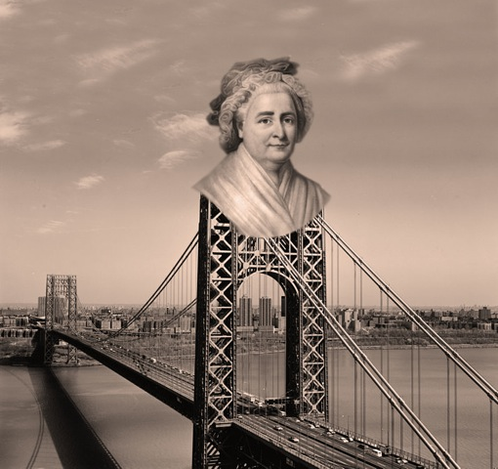

Slide 5
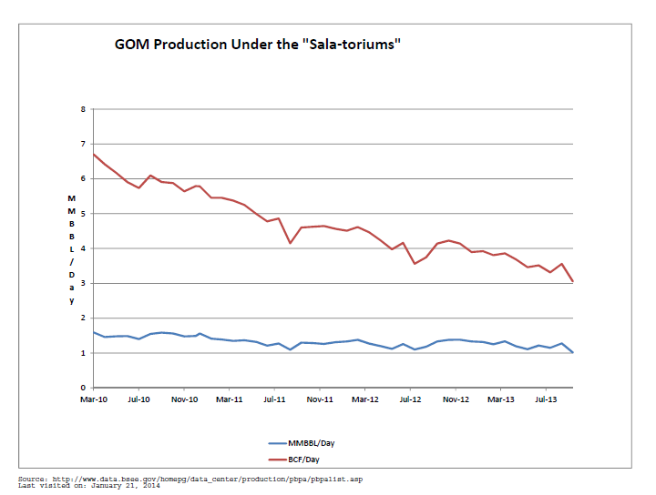

Slide 6
BIS Restrictions on Exports of Domestically Produced Crude Oil
The Energy Policy and Conservation Act (EPCA) requires the President to restrict the export of domestically produced crude oil (Section 103);
The Mineral Leasing Act (MLA) restricts exports of domestic crude oil transported by pipeline over Federal rights-of-way granted under Section 28(u);
The Naval Petroleum Reserves Production Act (NPRPA) of 1976 restricts exports of petroleum (crude or refined products) produced from the Naval Petroleum Reserves; and
The Outer Continental Shelf Lands Act (OCSLA) restricts exports of crude oil or natural gas produced from Federally owned submerged lands of the Outer Continental Shelf.

Slide 7
Types of Transactions BIS Generally Approves
Exports to Canada for consumption or use therein (15 C.F.R. 754.2(e))
Exports from Alaska’s Cook Inlet (15 C.F.R. 754.2(d))
Exports in connection with refining or exchange of strategic petroleum reserve oil (15 C.F.R. 754.2(f))
Exports of heavy California crude oil up to an average volume not to exceed 25 MB/D (15 C.F.R. 754.2(g))
Exports that are consistent with international agreements (15 C.F.R. 754.2(c))
Exports that are consistent with findings made by the President under an applicable statute (15 C.F.R. 754.2(c))
Exports of foreign origin crude oil where, based on written documentation satisfactory to BIS, the exporter can demonstrate that the oil is not of U.S. origin and has not been commingled with oil of U.S. origin (15 C.F.R. 754.2(b)(vii)

Slide 8
Transactions Consistent with Purpose of EPCA
Exports that will result directly in the importation into the United States of an equal or greater quantity and an equal or better quality of crude oil or of a quantity and quality of identified petroleum products that is not less than the quantity and quality of commodities that would be derived from the refining of the crude oil for which an export license is sought; and
Exports that will take place only under contracts that may be terminated if the petroleum supplies of the United States are interrupted or seriously threatened; and
Exports in which the applicant can demonstrate that, for compelling economic or technological reasons that are beyond the control of the applicant, the crude oil cannot reasonably be marketed in the United States; and
Exports involving temporary exports or exchanges that are consistent with the identified requirements

Slide 9
Condolences May Be Sent To
Stefan.reisinger@nortonrosefulbright.com

Slide 11
2012 Transboundary Treaty
* Delimitation Line
* Hydrocarbon Occurrence Near the Delimitation Line
* Transboundary Reservoir
* Joint Commission
* Expert Determination

Slide 12
Poe Contact Information:
Houston: 713-651-5298
Denver: 303-801-2746
Poe.leggette@nortonrosefulbright.com

Slide 13
Disclaimer
Norton Rose Fulbright LLP, Norton Rose Fulbright Australia, Norton Rose Fulbright Canada LLP, Norton Rose Fulbright South Africa (incorporated as Deneys Reitz Inc) and Fulbright & Jaworski LLP, each of which is a separate legal entity, are members (“the Norton Rose Fulbright members”) of Norton Rose Fulbright Verein, a Swiss Verein. Norton Rose Fulbright Verein helps coordinate the activities of the Norton Rose Fulbright members but does not itself provide legal services to clients. References to “Norton Rose Fulbright”, “the law firm”, and “legal practice” are to one or more of the Norton Rose Fulbright members or to one of their respective affiliates (together “Norton Rose Fulbright entity/entities”). No individual who is a member, partner, shareholder, director, employee or consultant of, in or to any Norton Rose Fulbright entity (whether or not such individual is described as a “partner”) accepts or assumes responsibility, or has any liability, to any person in respect of this communication. Any reference to a partner or director is to a member, employee or consultant with equivalent standing and qualifications of the relevant Norton Rose Fulbright entity. The purpose of this communication is to provide information as to developments in the law. It does not contain a full analysis of the law nor does it constitute an opinion of any Norton Rose Fulbright entity on the points of law discussed. You must take specific legal advice on any particular matter which concerns you. If you require any advice or further information, please speak to your usual contact at Norton Rose Fulbright.

